Slide 1
DSD Presentation RISCV-G3
B07901021 潘世軒
B07901036 陳俊廷
B07901137 吳陽禾

Slide 2
Outline
Baseline
Extension
Branch prediction
Compression
L2 cache

Slide 3
Outline
Baseline
Extension
Branch prediction
Compression
L2 cache

Slide 4
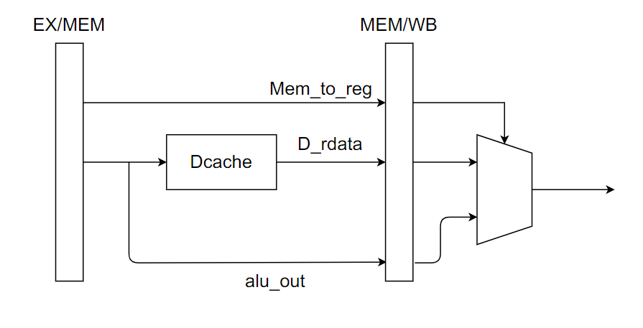
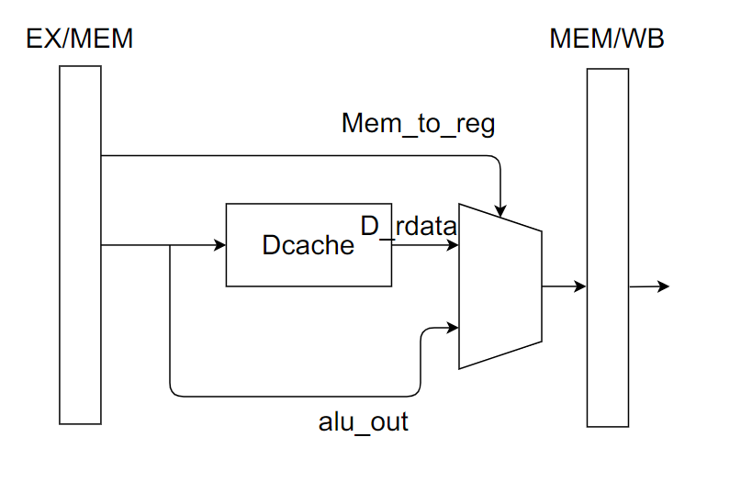
Optimization: move logic before ff to save area
1
32
32
32
Before: FF 65 bits
Before: FF 32 bits
And make sure the critical path won’t be longer !

Slide 5
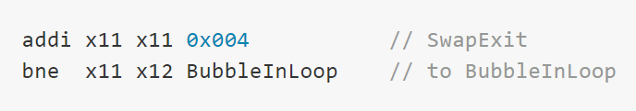
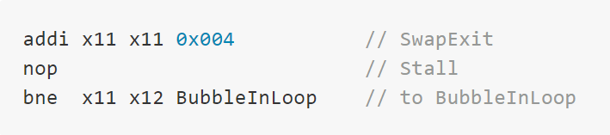
Optimization: Stall for specific branch, jalr
Main purpose: shorten the critical path
We do the same thing for jalr case
But jalr case didn’t appear in I_mem_hasHazard

Slide 6
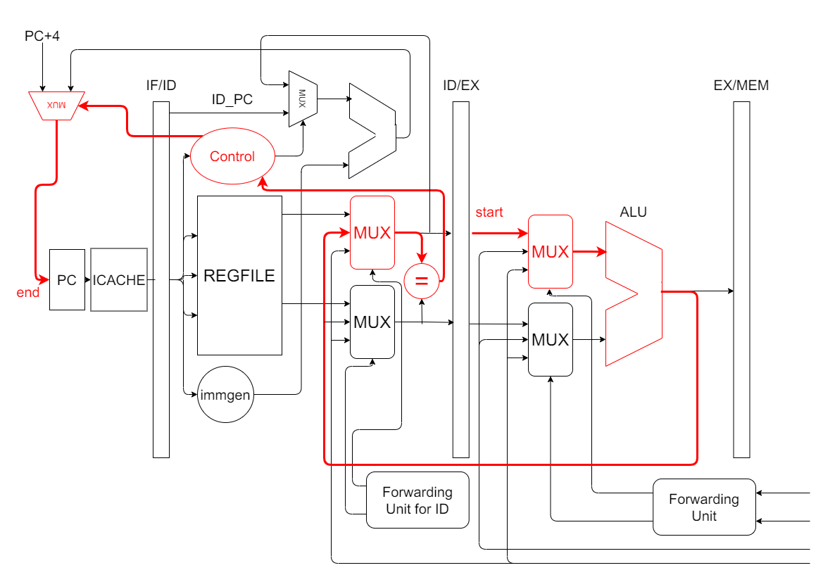
bne x11 x12 Inloop
addi x11 x11 0x004
Before stalling

Slide 7
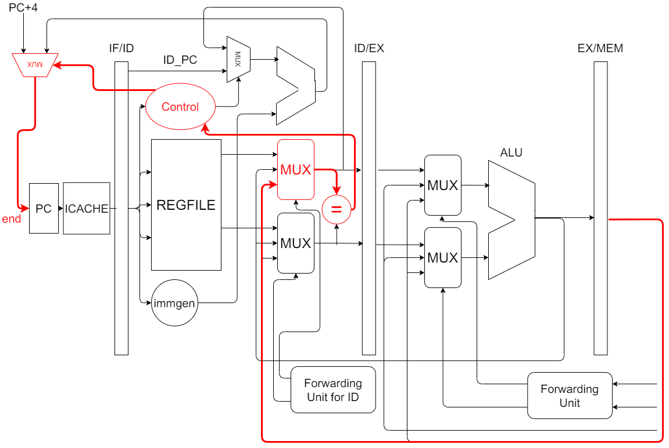
bne x11 x12 Inloop
nop
addi…
After stalling

Slide 8
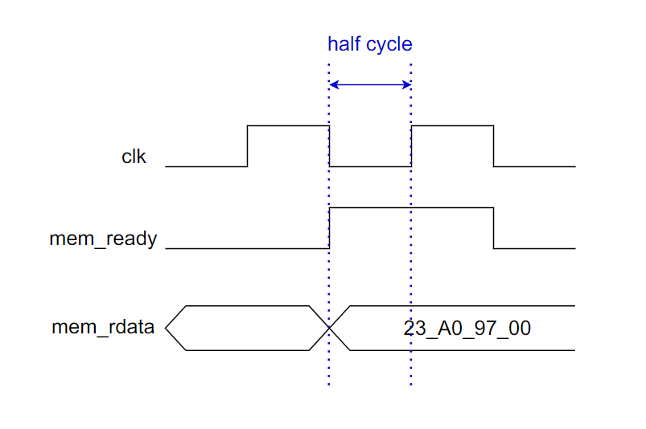
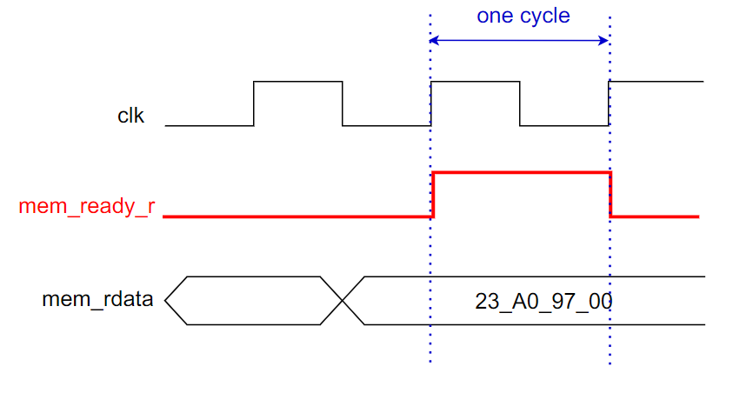
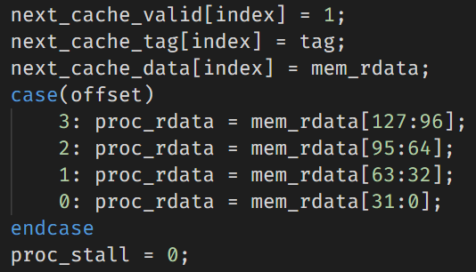
Optimization: flipflopped mem_ready
Add a flipflop for mem_ready
Make sure we have enough time to do the following things
Decoder, multiplexer…
No setup time violation !

Slide 9
Optimization: direct-mapped Icache
Instructions are executed sequentially (sometimes loop)
Using direct-mapped Icache can reduce the cost of decoder, mul…
Also, it can shorten the “hit access time” of Icache
2-way associative
Direct-mapped
Notes:
這頁可以不要講

Slide 10
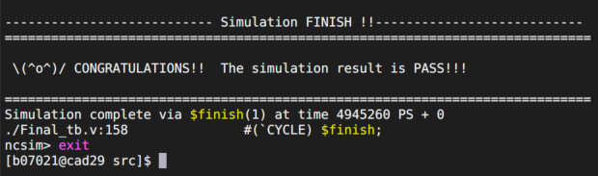
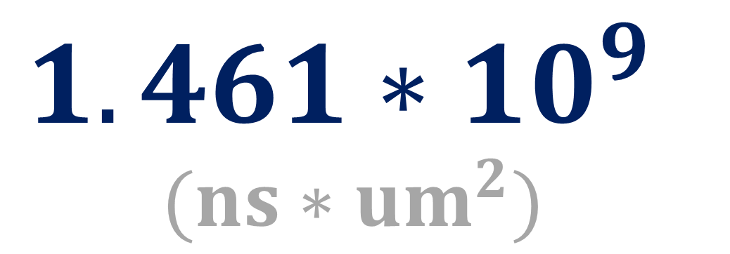
Our AT value:
$$1.461∗{10}^{9} \\ (ns∗{um}^{2})$$
sdc cycle: 2.55
Total time: 4945.26 (tb =2.41)
Area: 295357.8

Slide 11
Outline
Baseline
Extension
Branch prediction
Compression
L2 cache

Slide 12
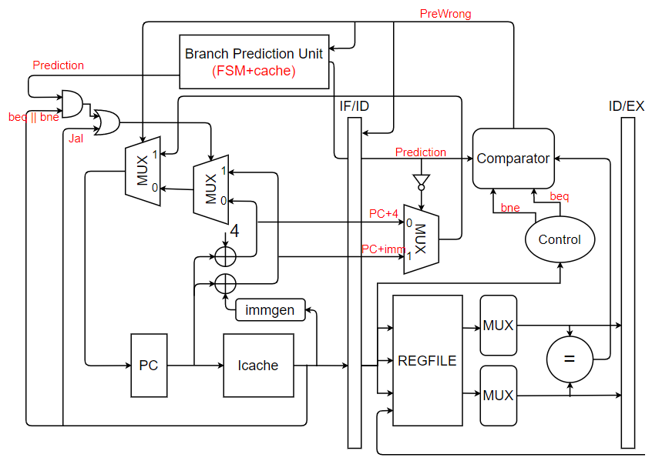
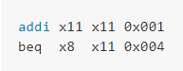
Block diagram
A: BPU for beq and bne predict for taken or not taken
A
FSM
B: Jal “beq always branch” move it to IF stage along with beq, bne
B
No need to stall for the following case: (because of the change of critical path)

Slide 13
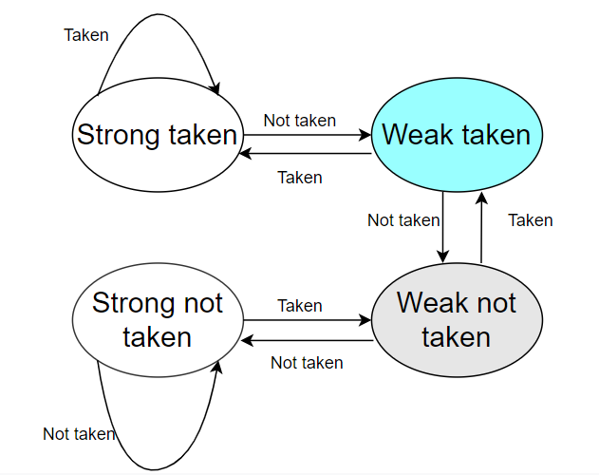
Finite State Machine
Notes:
這頁可以不要講

Slide 14
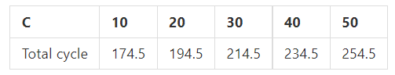
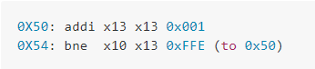
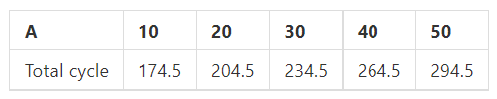
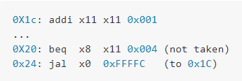
Experiment1
Change runtimes of part C (always branch) (a10b10) -> Good Prediction
Change runtimes of part A (never branch) (b10c10) -> Good Prediction
Notes:
這頁可以不要講

Slide 15
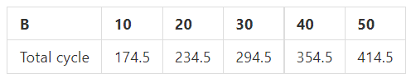
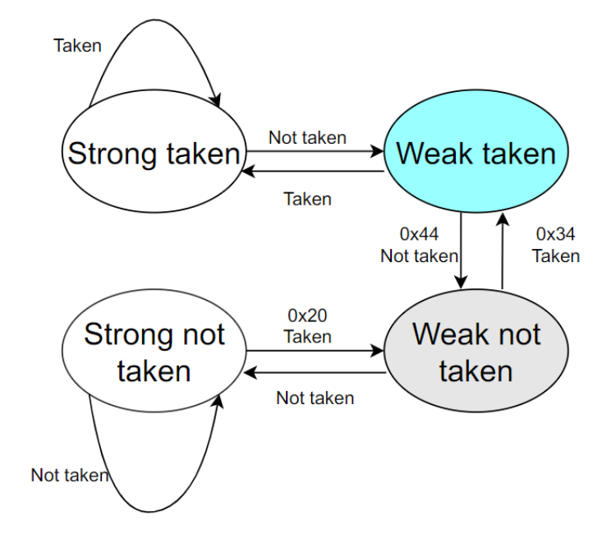
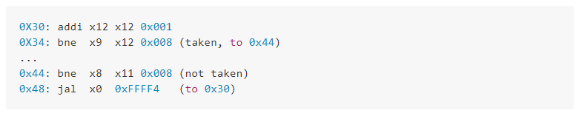
Experiment1
Worst case: 100% failed
Best case: 50% failed
Change runtimes of part B (interleaved) (a10c10) -> Cannot handle it

Slide 16
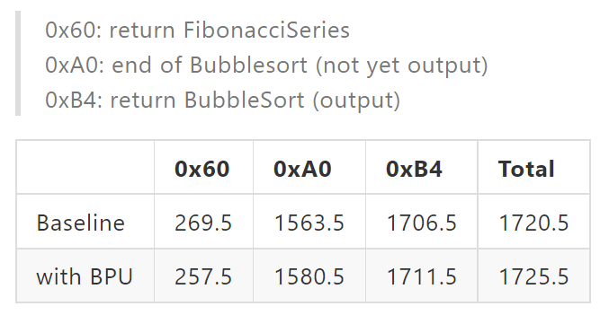
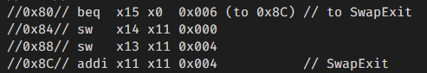
Experiment2
Use two circuits to execute I_mem_hasHazard. I cancel the stalled cycle for above case. So the only difference is the BPU. Baseline always fetch PC+4 first -> PREDICT NEVER TAKEN
Fibonacci: always taken
Bubble sort:
Swap in inner loop: Random (never taken)
Inner loop: always taken
Outer loop: always taken
Bubble sort output: always taken
actually
Cumulative cycles
Notes:
這頁可以不要講
提swap那裏會造成交錯就好

Slide 17
Summary
Characteristics of 2-bit predictor
1. Can deal with single loop (always taken or never taken)
2. Can deal with one “if” in single loop (Look before you leap!)
EX: swap in inner loop
3. Cannot deal with interleaved pattern

Slide 18
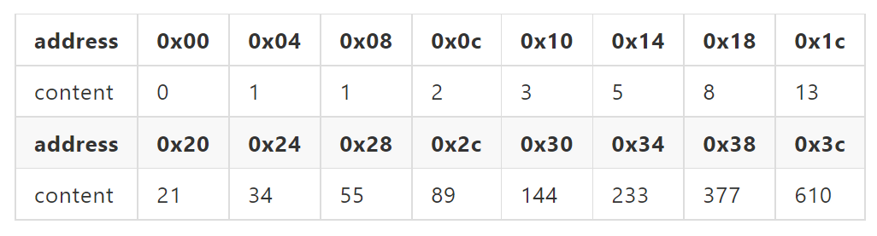
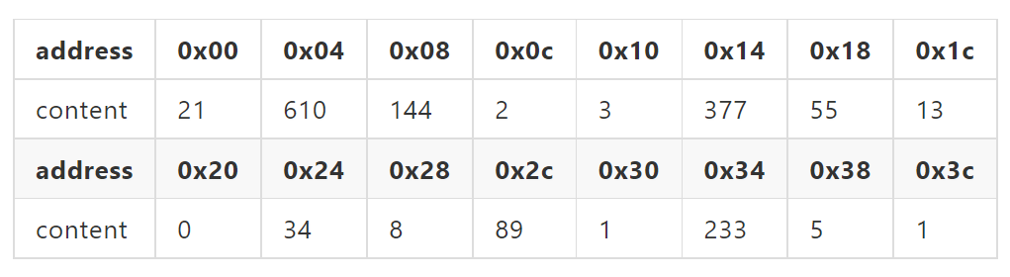
Experiment3
Branch prediction unit: can do prediction but at the cost of area and the increase in critical path
To see how this trade-off affect the performance, I run I_mem_hasHazard_modified for BPU and baseline after synthesis

Slide 19
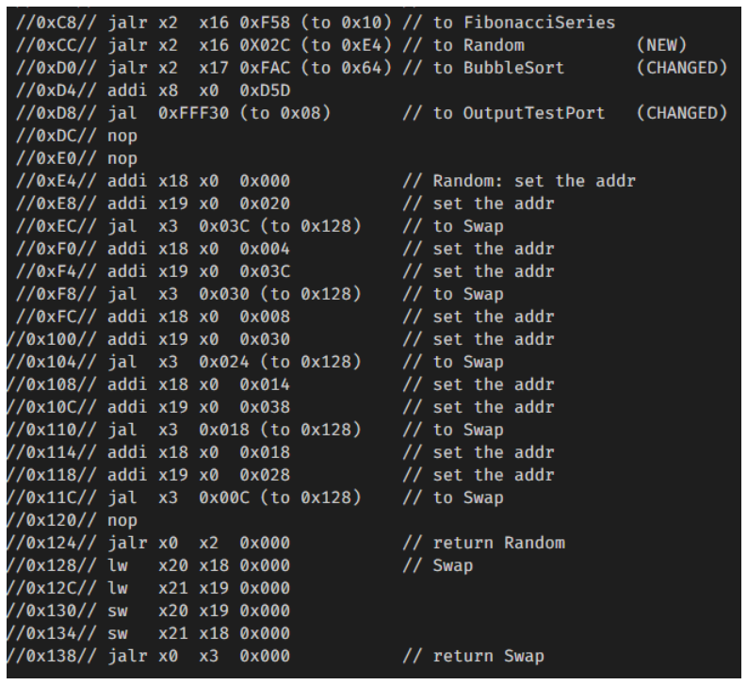
Experiment3

Slide 20
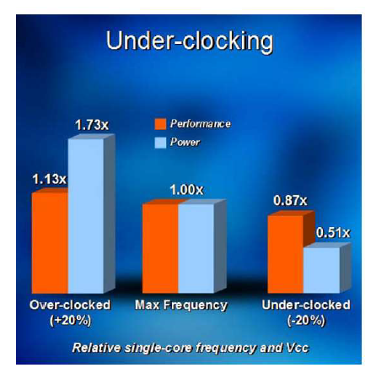
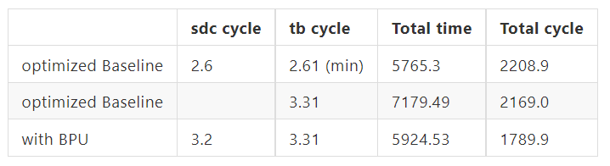
Experiment3
Due to the gap of cycle, Baseline still win in time.
But actually, CPU with such high frequency will consume much more power.
So I think using Branch prediction unit in CPU is a good choice and it can decrease the run time and run cycle.

Slide 21
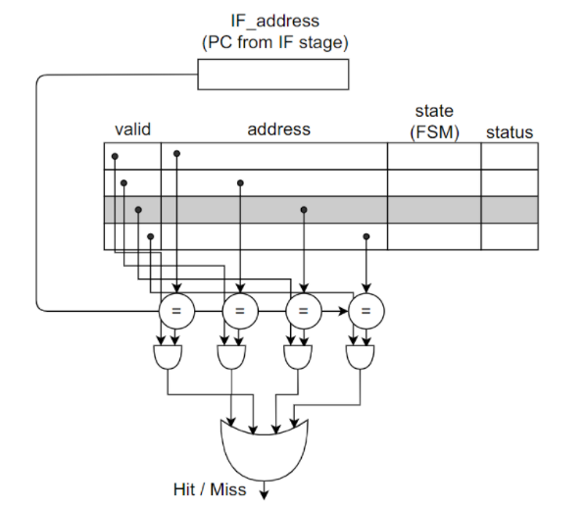
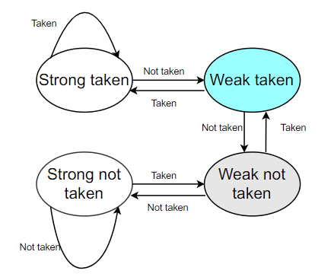
Other architecture of BPU
Branch prediction buffer (cache)
Consider the miss for 1-bit predictor (leave loop and enter loop -> wrong) I put 2-bit predictor in FSM for each address
Fully-associative (check all address)
Replacement policy: bit-pseudo-LRU
When the addr used, assert its status (0->1)
When all status asserted, clear (all to 0)
When addr miss, choose block with status to be replaced

Slide 22
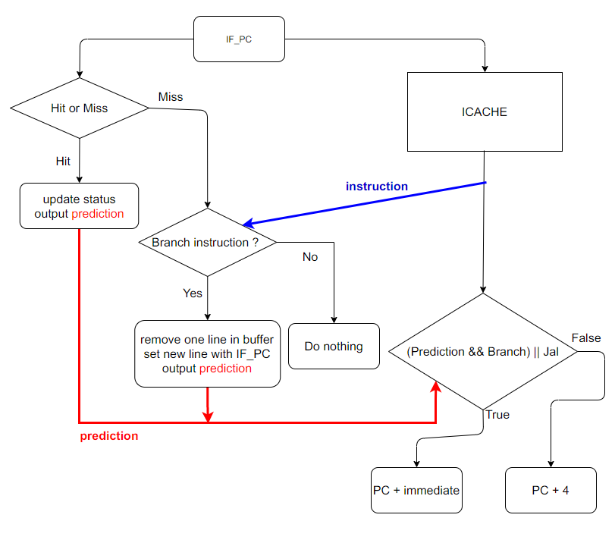
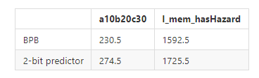
BPB
Flow diagram of IF stage ->
We can find that the performance of BPB is further improved

Slide 23
Outline
Baseline
Extension
Branch prediction
Compression
L2 cache

Slide 24
Target
Decompress
PC control
I_CACHE alignment

Slide 25
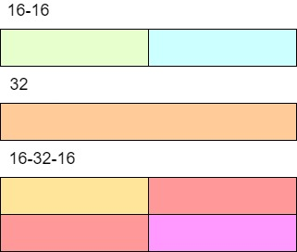
Instruction Type

Slide 26
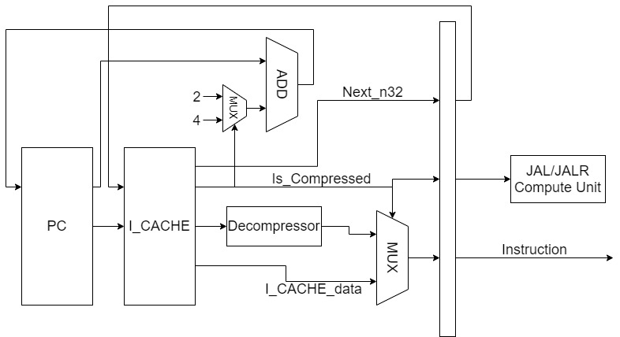
Decompress + PC Control

Slide 27
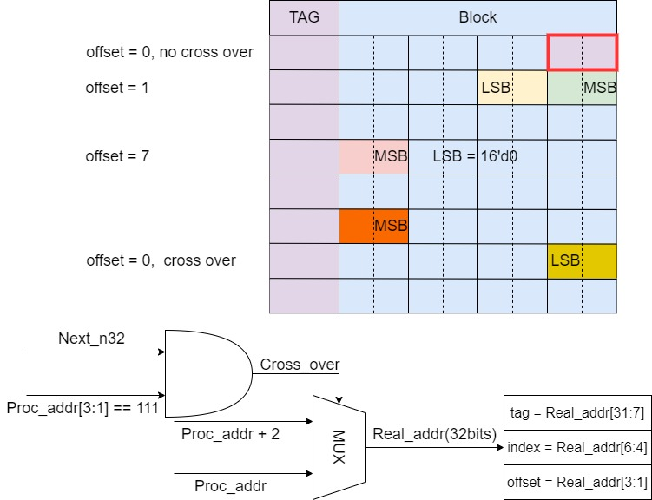
ICACHE
If the offset is 7(ex: 0x4E), and the next instruction is 32 bits, then cross_over = 1, we need to read the next block(0x50).

Slide 28
Performance
Sdc Cycle(ns) | 3
Design Area(μm^2) | 18338.709635
Decompression Execution Cycle | 520.5
Compression Execution Cycle | 431.5
Decompression ICACHE stall | 14
Compression ICACHE stall | 8

Slide 29
Outline
Baseline
Extension
Branch prediction
Compression
L2 cache

Slide 30
Why L2 Cache ?
L1 Cache miss penalty too big
(6% in baseline tb, 7.5% in L2 tb)
Definitely be larger in reality

Slide 31
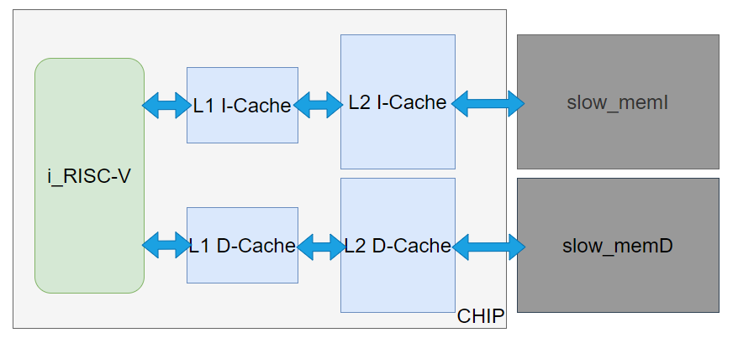
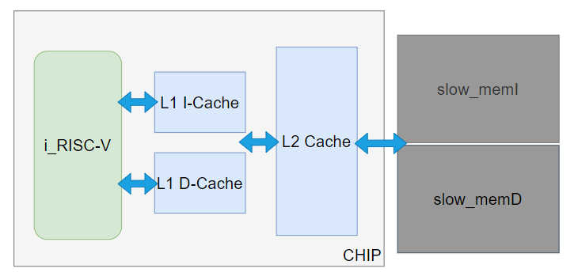
Two types of L2 Cache
Split Cache Unified Cache
Can reduce write logic in L2 I-Cache
Shorter tag(address) matching time
Simpler logic design
Bigger bandwidth
Lower miss rate due to more blocks
(Unified Cache is more common in recent years.)

Slide 32
Split Cache
After implementation, we found that L2 D-Cache improve 14% performance

Slide 33
Split Cache
After implementation, we found that L2 D-Cache improve 14% performance
BUT
L2 I-Cache won’t do any better on L2’s tb
Due to L2 I-Cache’s 80% miss rate

Slide 34
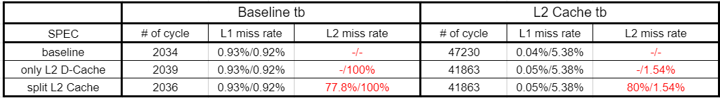
Split Cache
After implementation, we found that L2 D-Cache improve 14% performance
BUT
L2 I-Cache won’t do any better on L2’s tb
Due to L2 I-Cache’s 80% miss rate
(tb too simple)
miss rate: I-Cache/ D-Cache

Slide 35
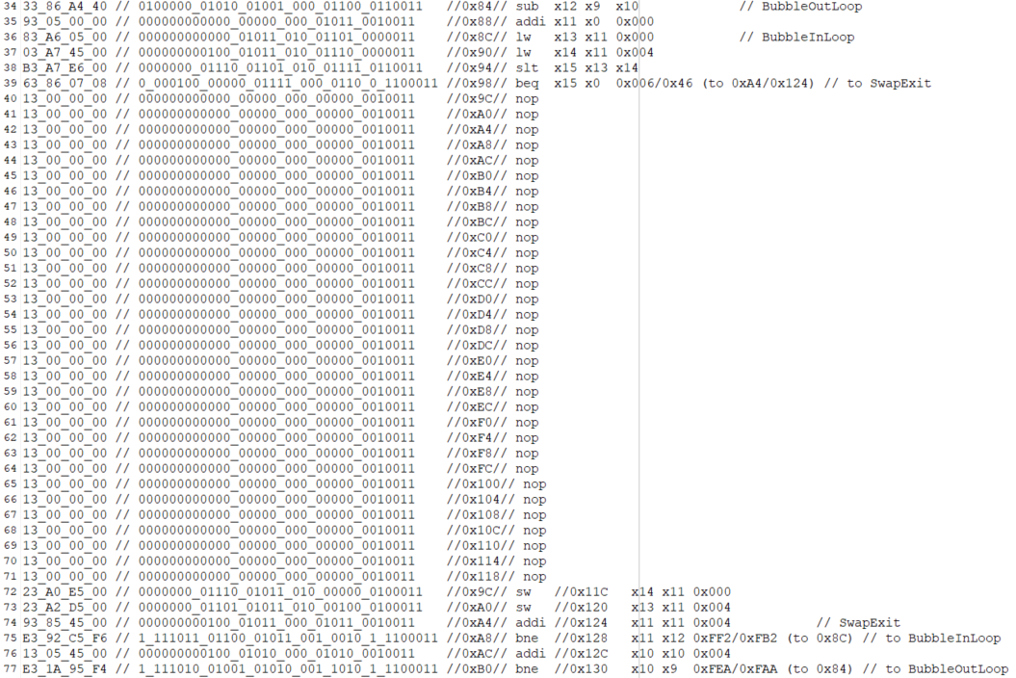
Split Cache
Therefore, we add some nop in swap loop(bubblesort) to make instruction more complicated.
32 nop
(because L1 cache can store 32 instructions)

Slide 36
Split Cache
Results for modified L2 Cache tb
33% improved
L2 I-Cache finally do something!

Slide 37
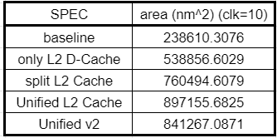
Unified Cache
Larger area
(Can’t reduce I-Cache’s write logic)
Proof I
4K D-Cache = 30W
8W reduced
4K I-Cache = 22W

Slide 38
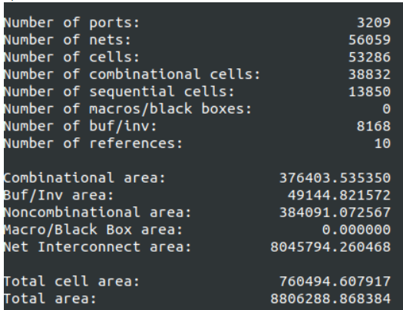
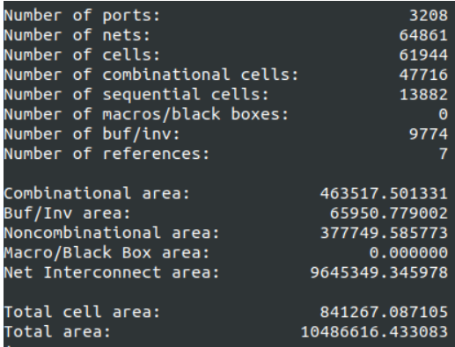
Unified Cache
Larger area
(Can’t reduce I-Cache’s write logic)
Proof II
Big difference in Combinational part
Non-combinational almost the same
Split
Unified

Slide 39
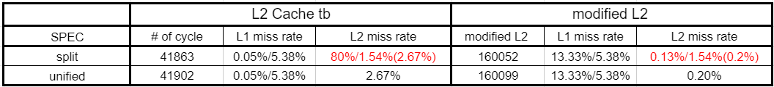
Unified Cache
Again, compare to size of L2 Cache, tb is too easy…
Can’t observe the benefit of using unified cache
miss rate: I-Cache/ D-Cache (weighted average)

Slide 40
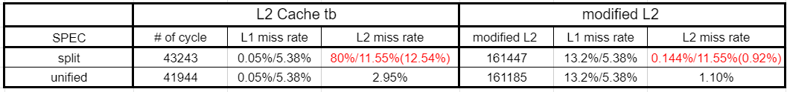
Unified Cache
Use total 32 blocks instead of 64 blocks
(L1 size x2)
miss rate: I-Cache/ D-Cache (weighted average)
Unified performs a lot better

